Slide 1
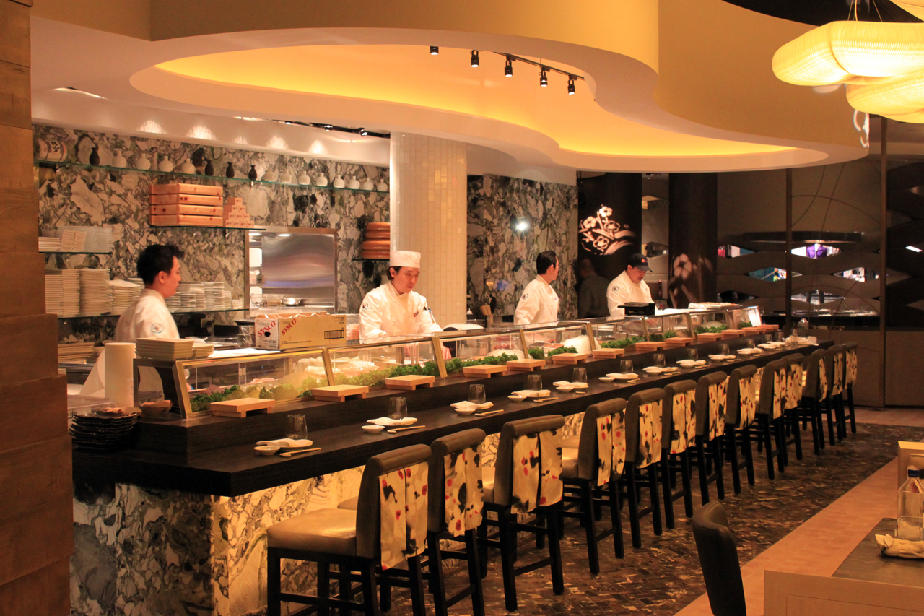
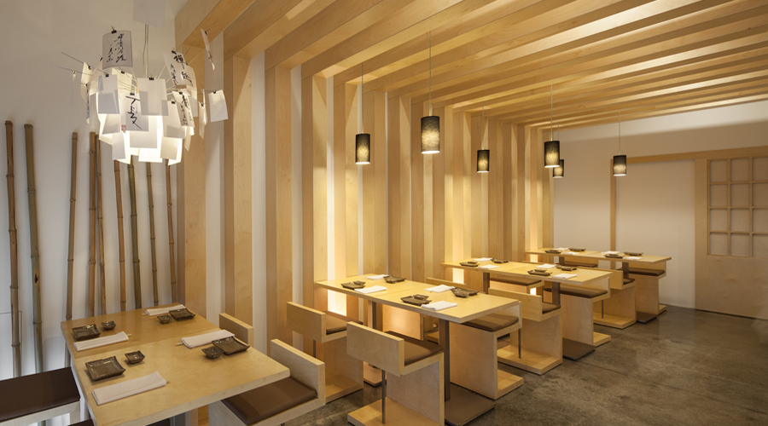
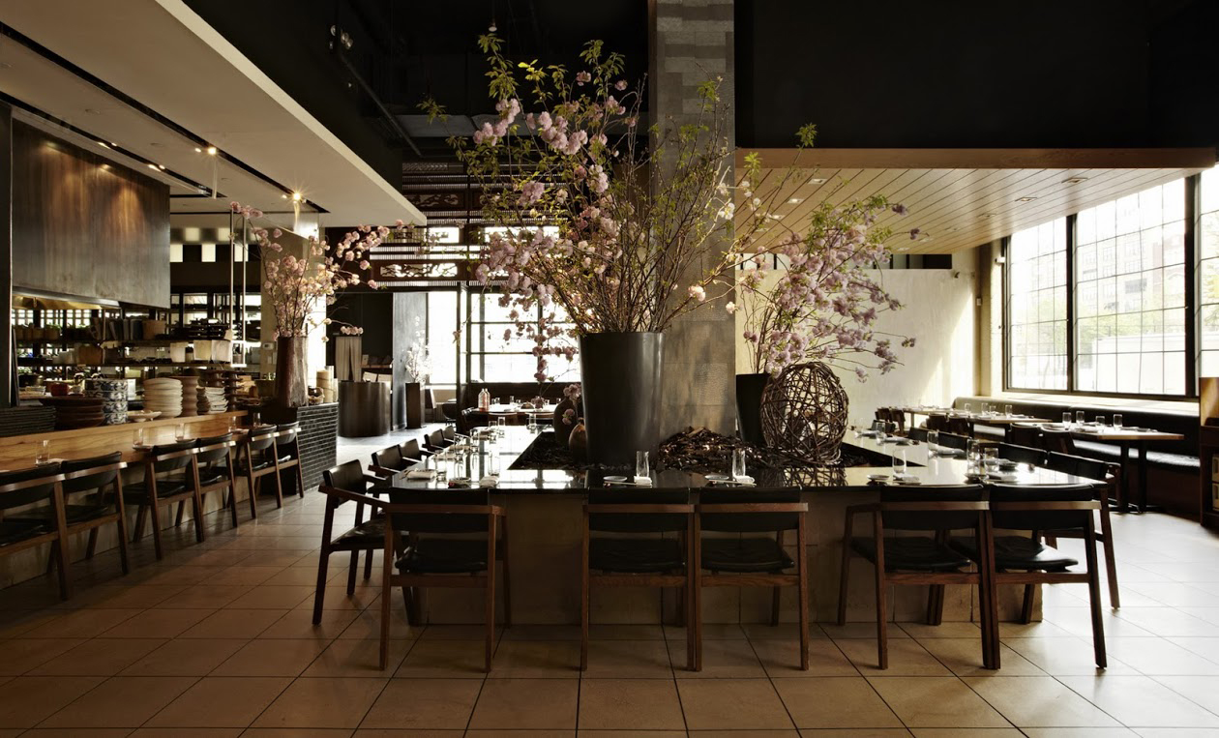
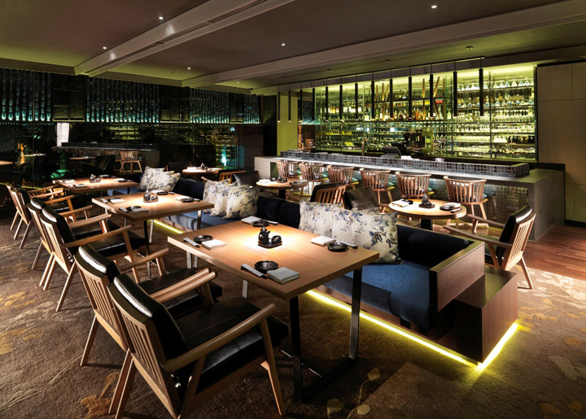
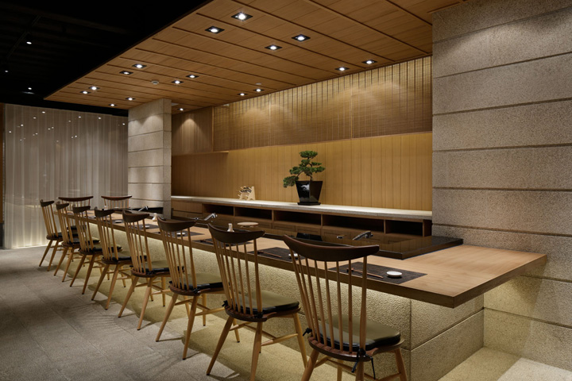
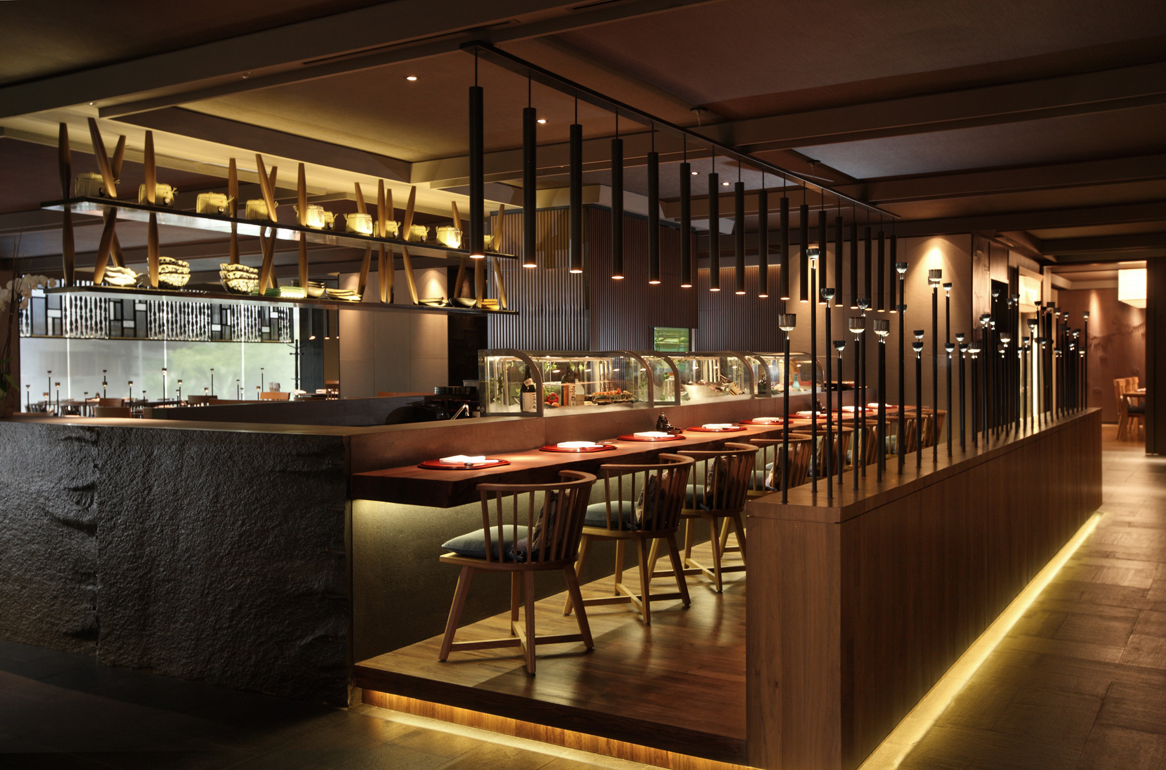
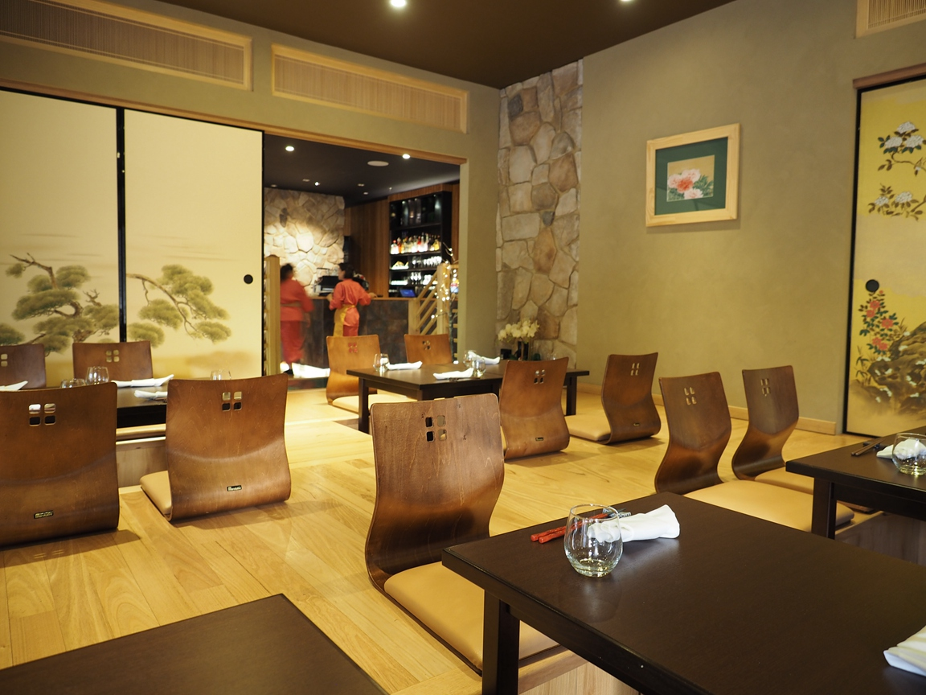
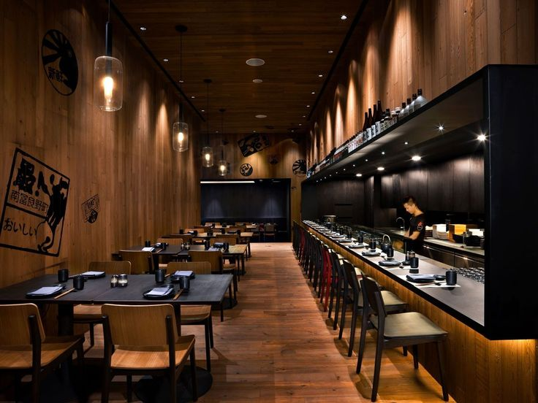
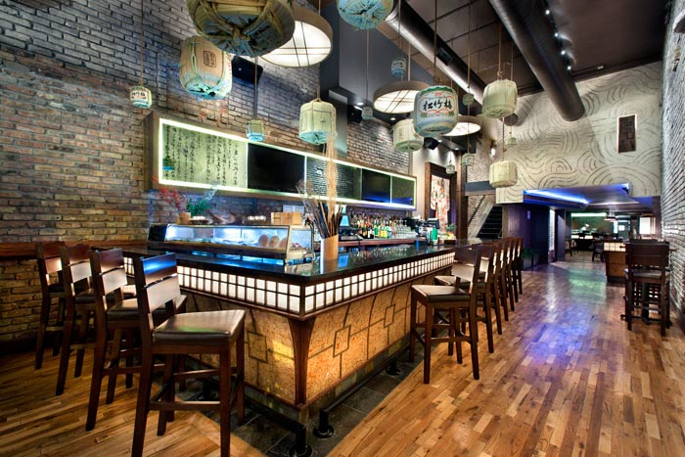
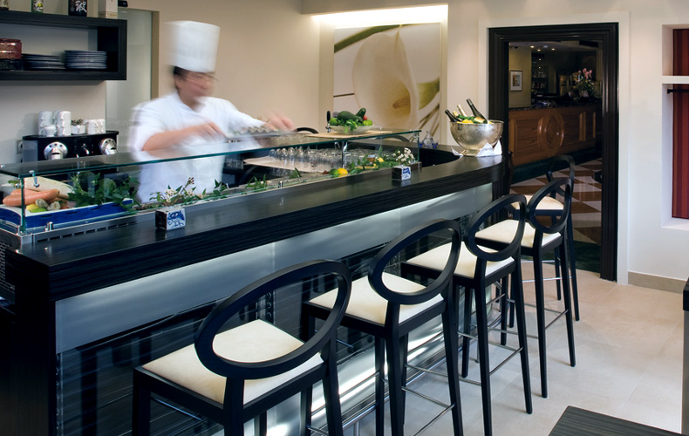
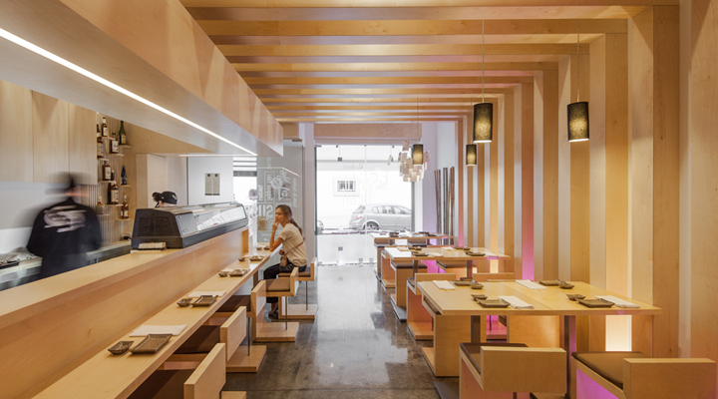
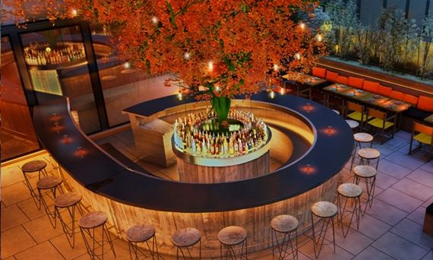
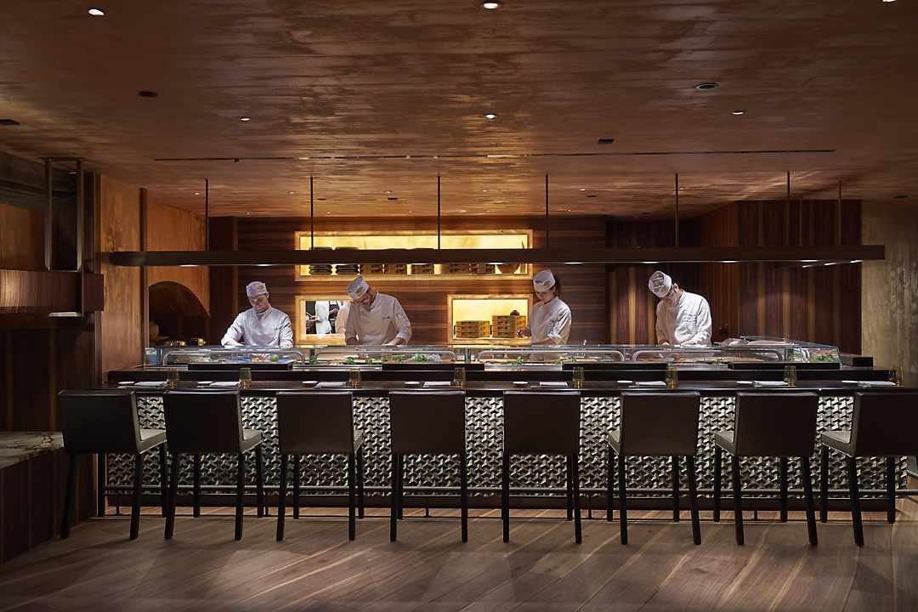
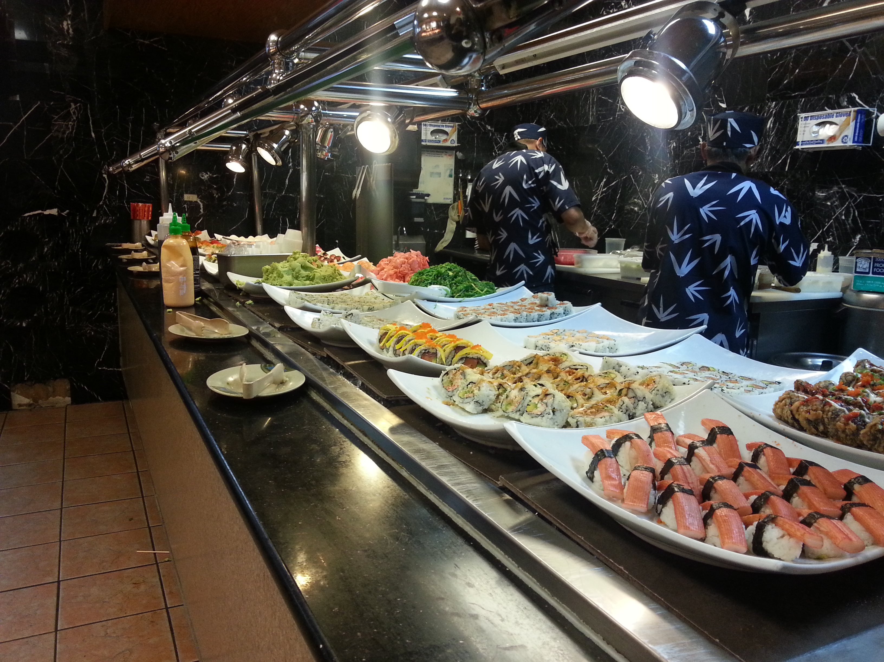
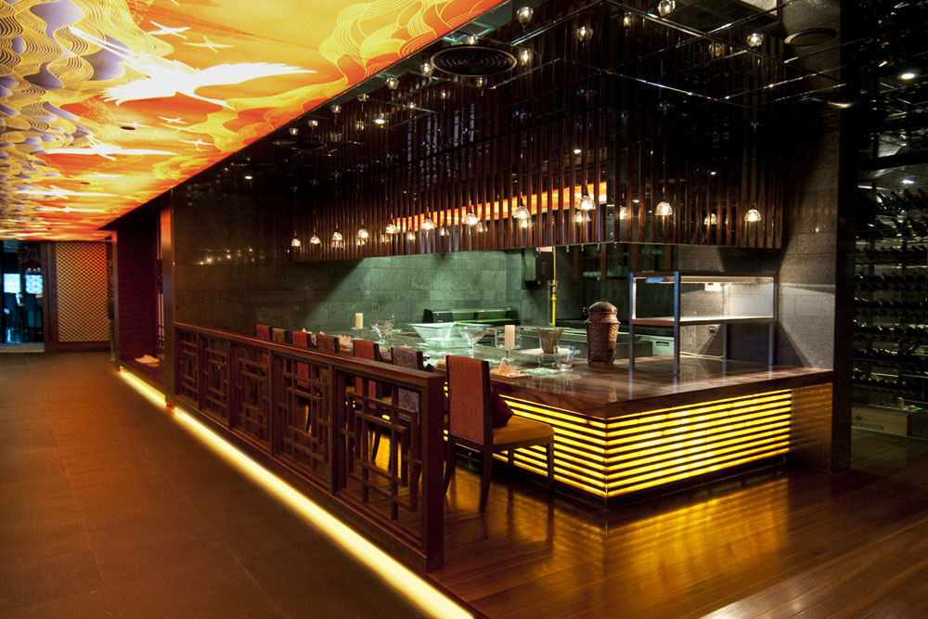
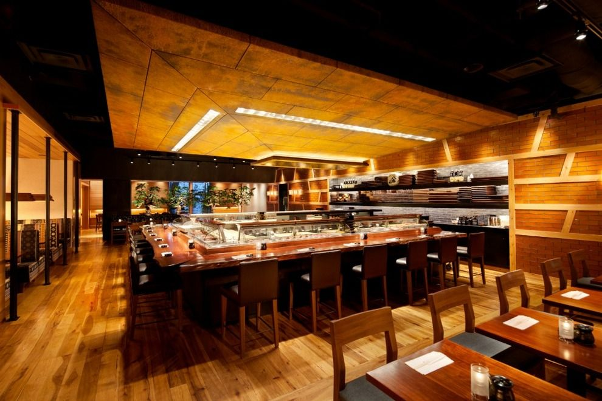
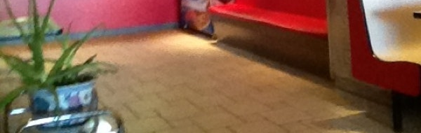
Notes:
In terms of visual clarity the floor is one of the least important elements in our game. It is supposed to act as a way to place the sushi bars in a more immersive setting. I also have to keep in mind that most of the floor will be covered by the customers, so I don’t want the final floor to create any unnecessary visual clutter, especially considering the game is supposed to be played on mobile devices which are much smaller in comparison to a PC or a console.
Above are pictures of various floors present in sushi bars. From these I can tell that the most common materials used in bar floors are wood and tiles. I decided to go with the wood material for the main floor, as I think that it creates a more natural feeling for the restaurant. Choosing wood as a floor material is also a stylish choice, which could imply to the players that the competition between the two bar owners is real and whoever wins the competition will own the bar.

Slide 2
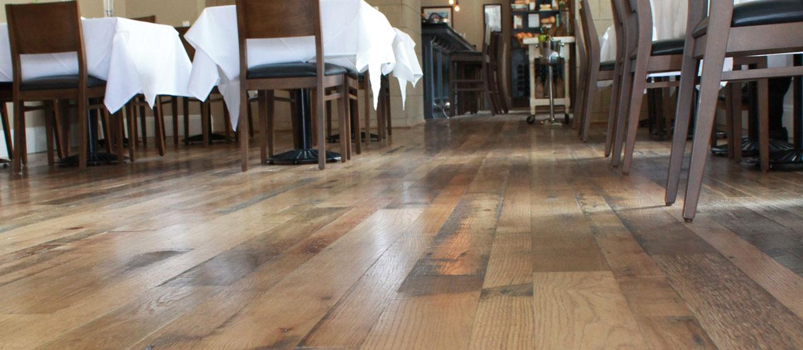
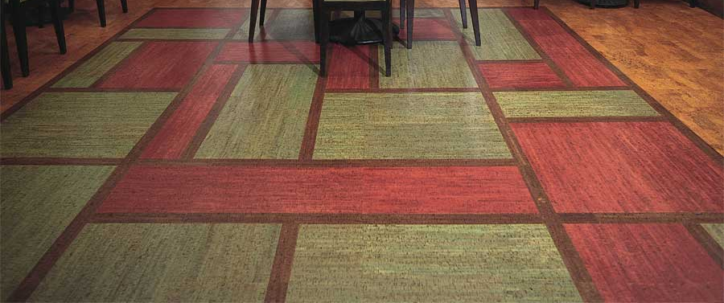
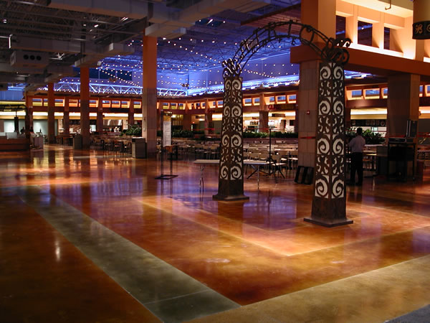
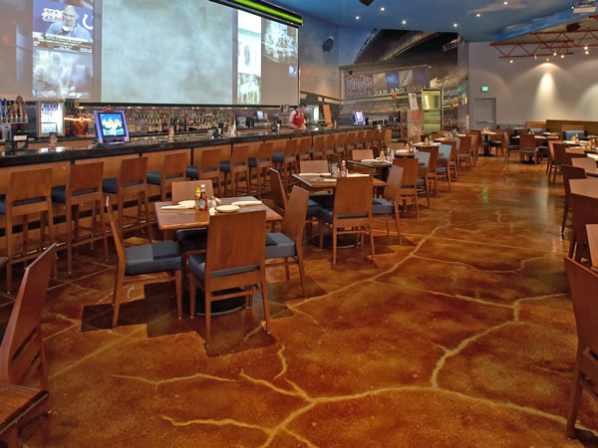
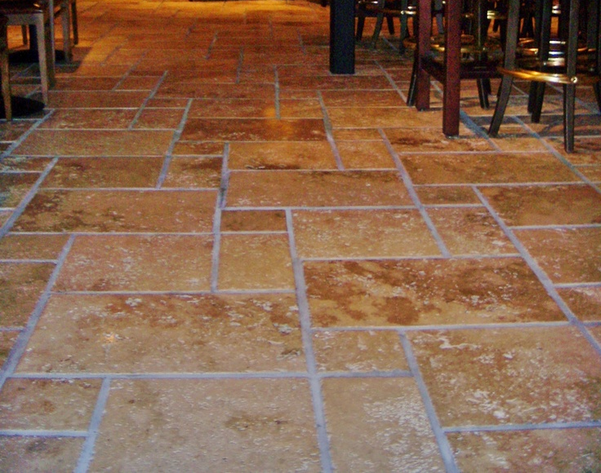
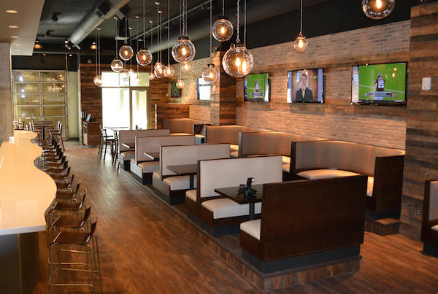
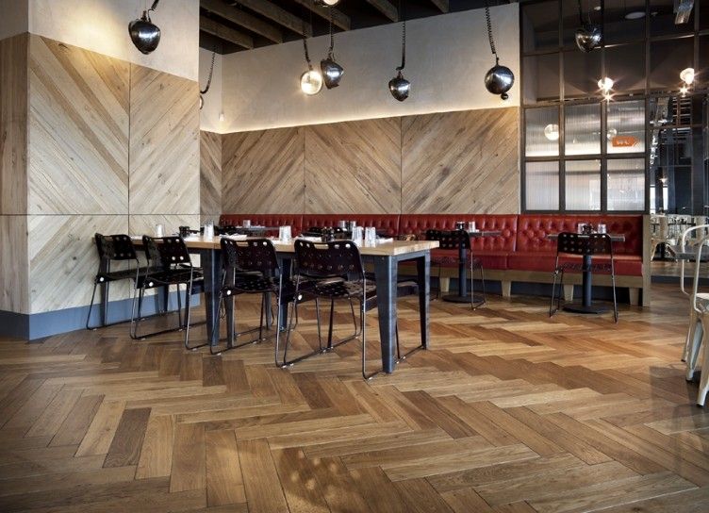
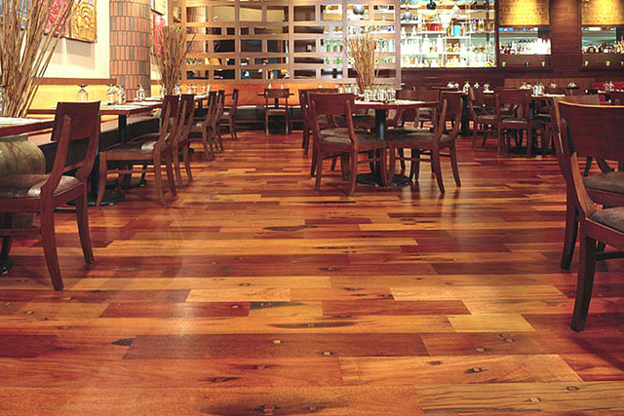
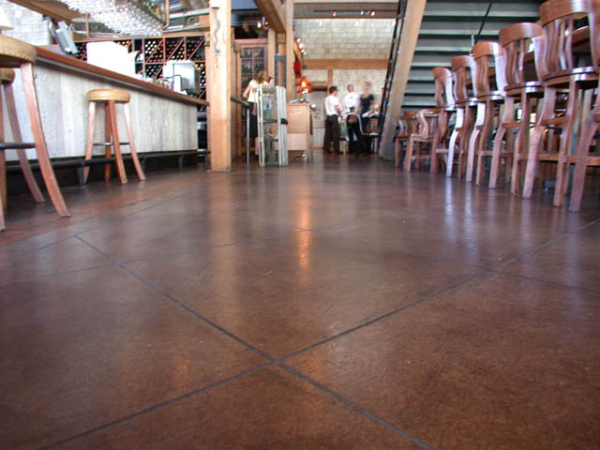
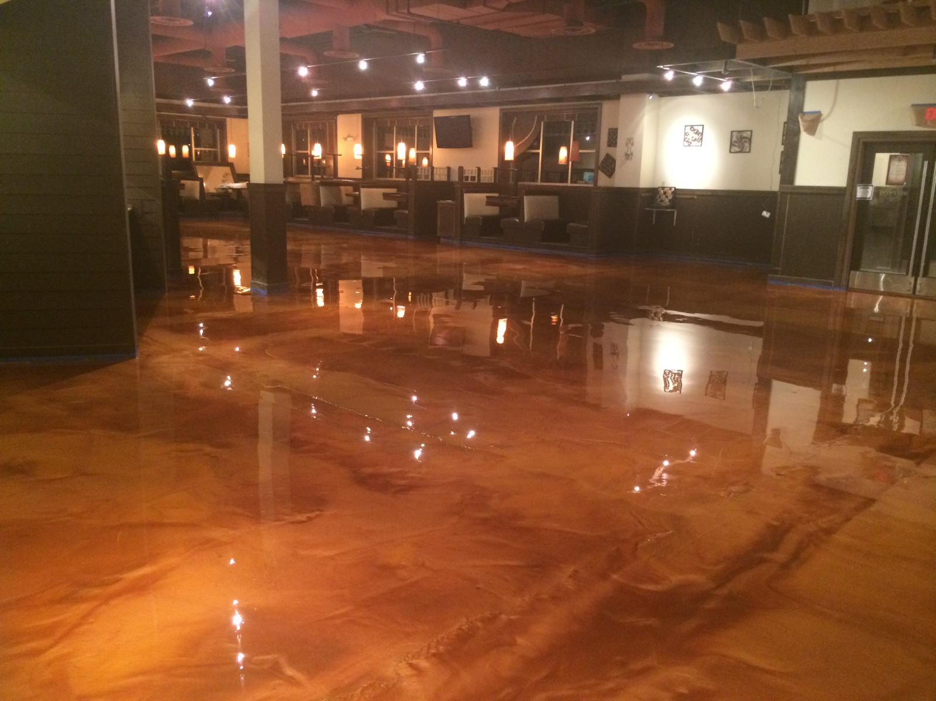
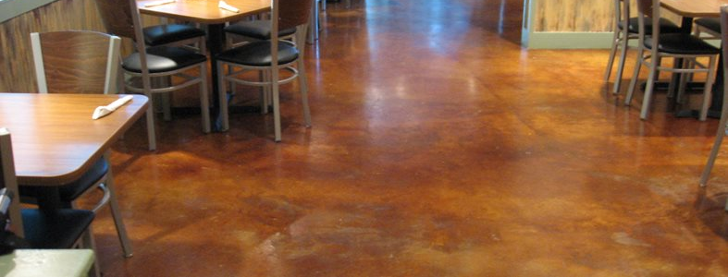
Notes:
I have also looked at floors in more common restaurants, and those appear to provide a wider choice. There are the wooded and tiled floors, as well as floors made of polished stone. Overall some of these restaurants appear to use variety of colours for the floor, whilst some go in with a patter for the floor (like the criss-cross wooden floor). I don’t think it would be wise to use complex designs for the floor, as we don’t want the players confused.

Slide 3
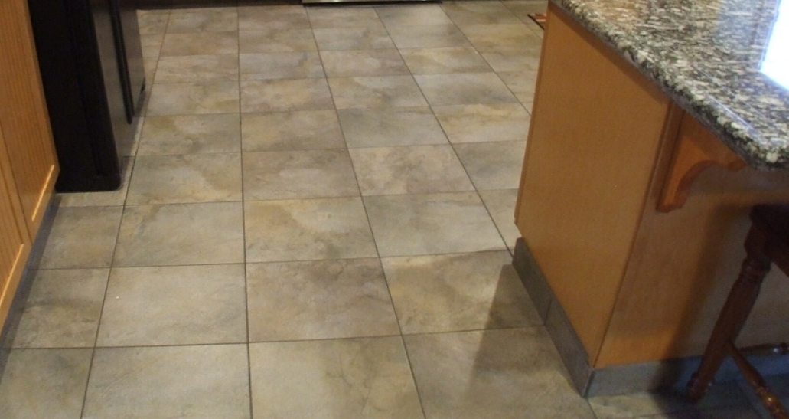
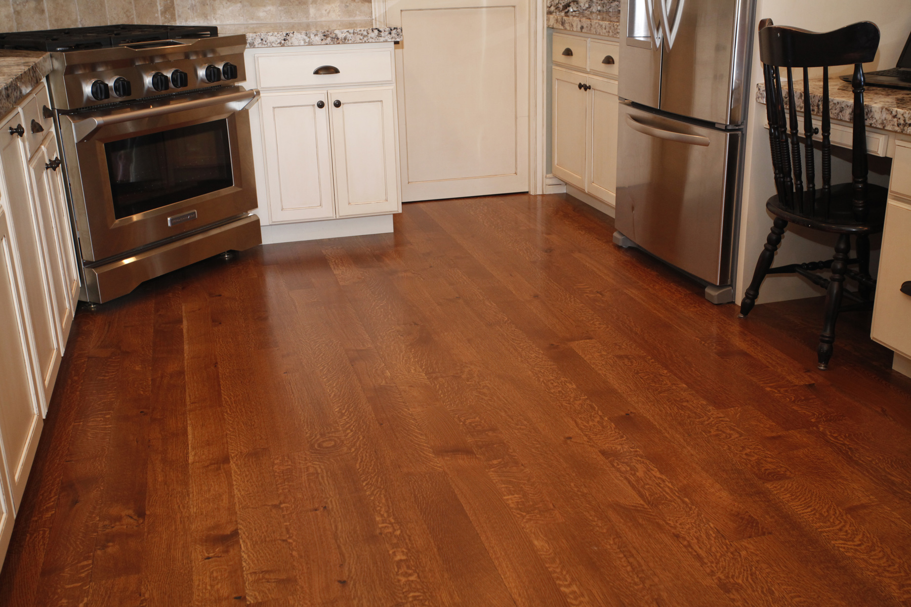
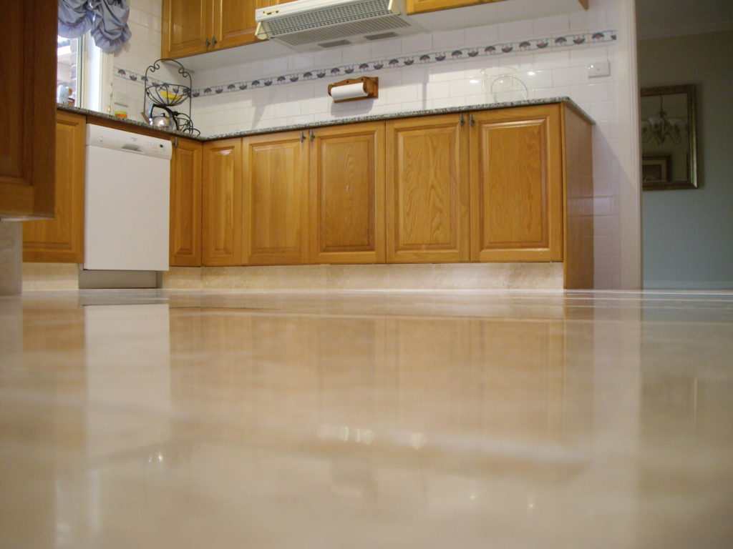
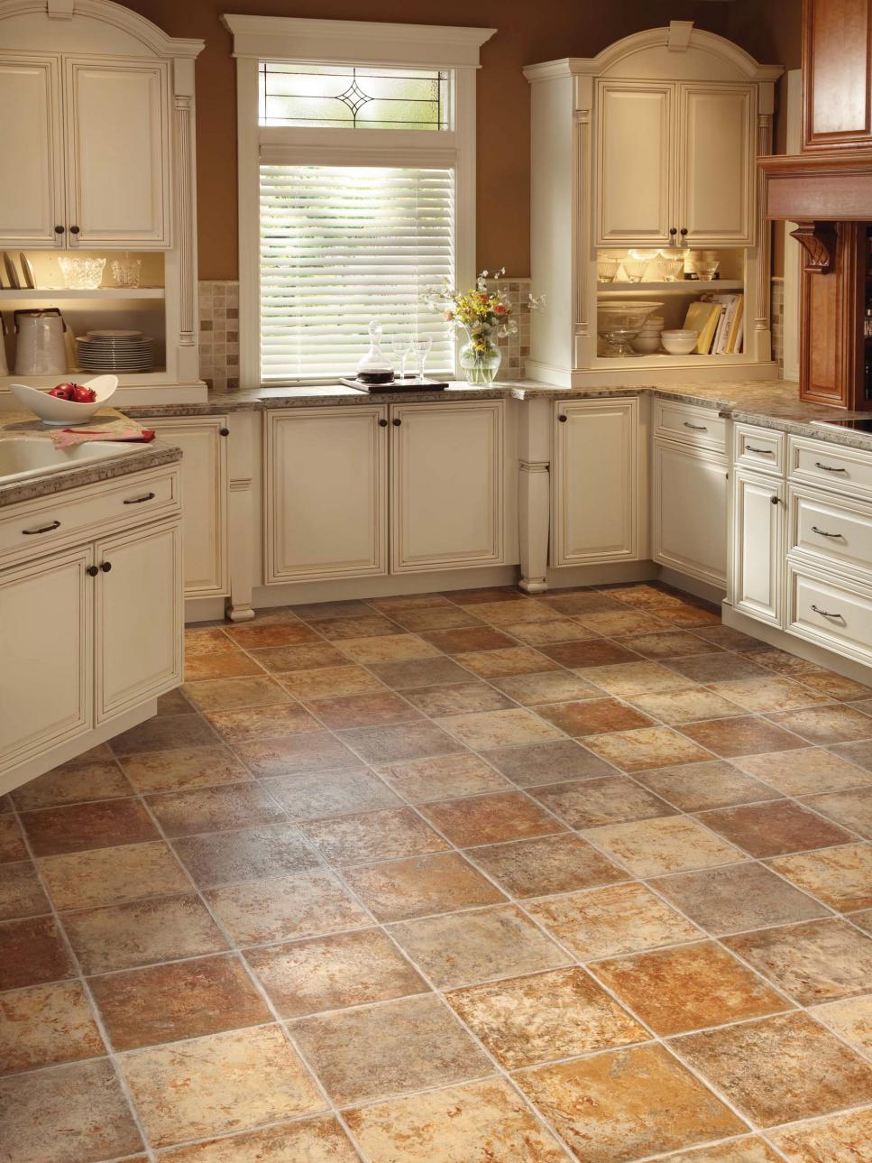
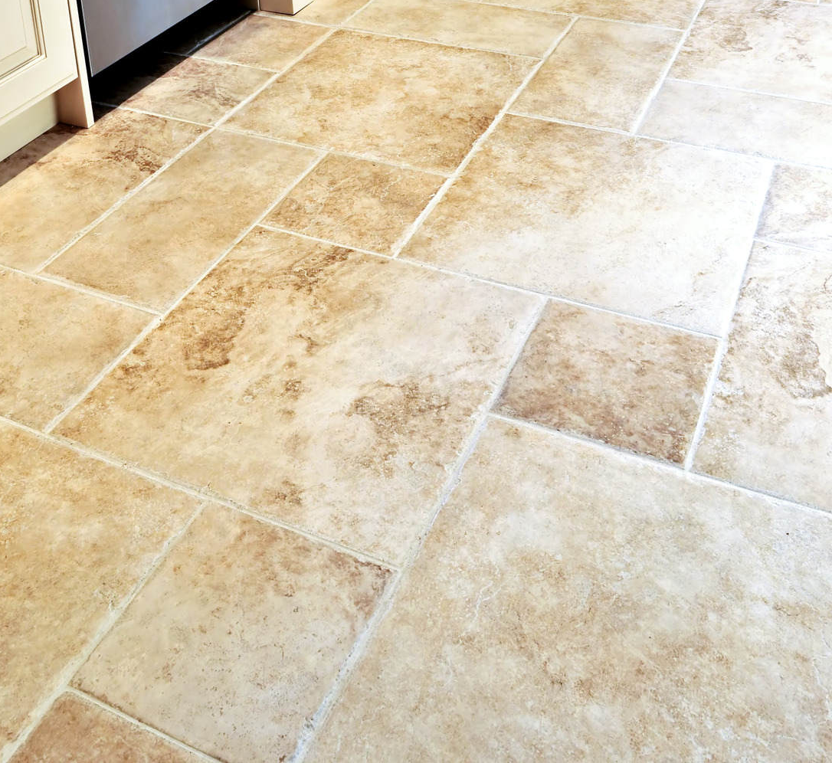
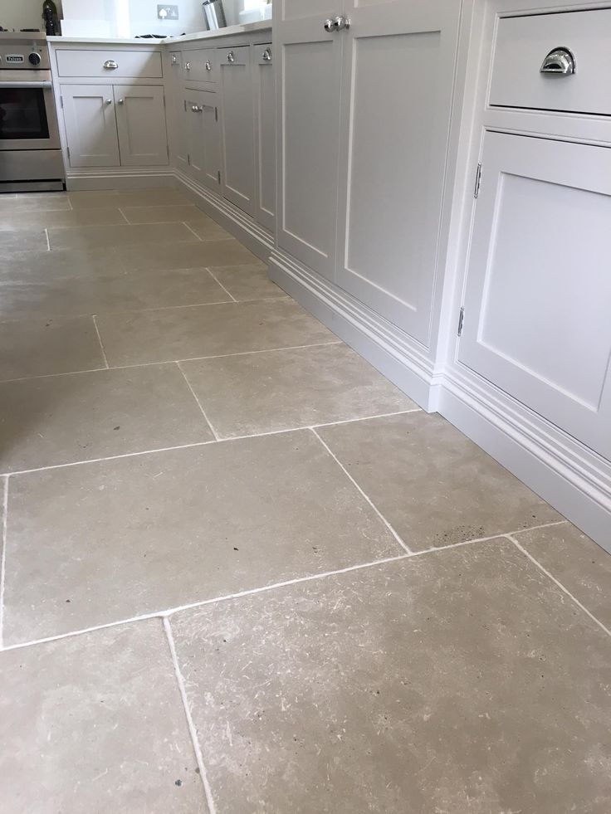
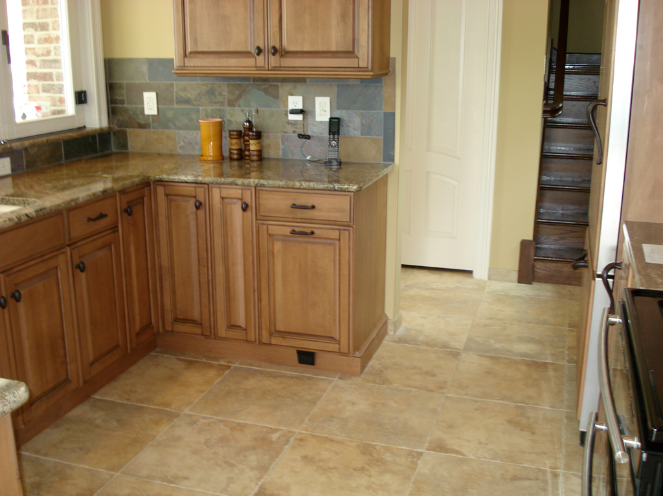
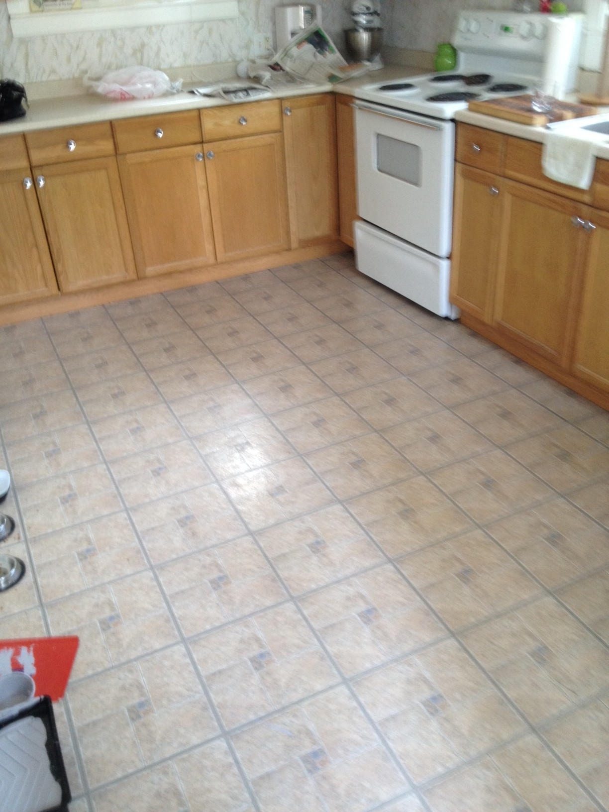
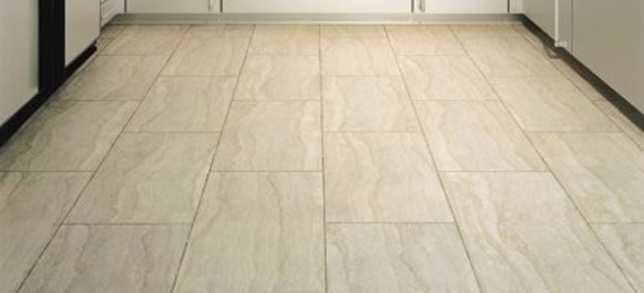
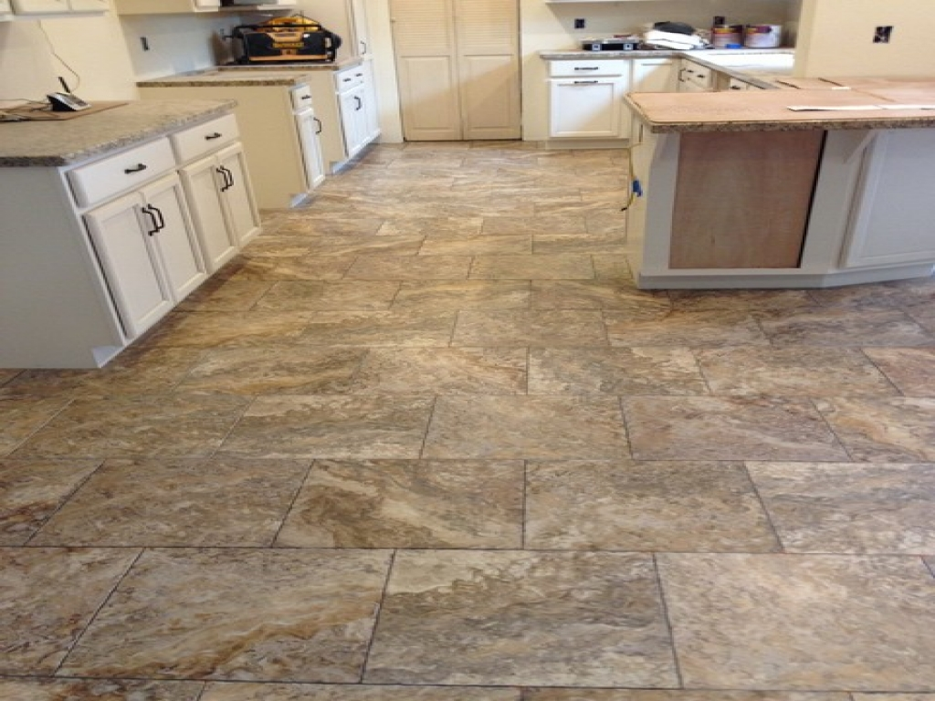
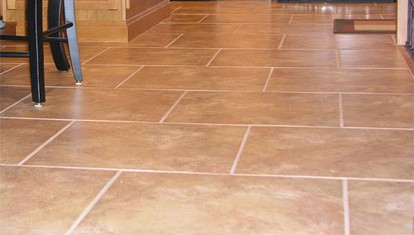
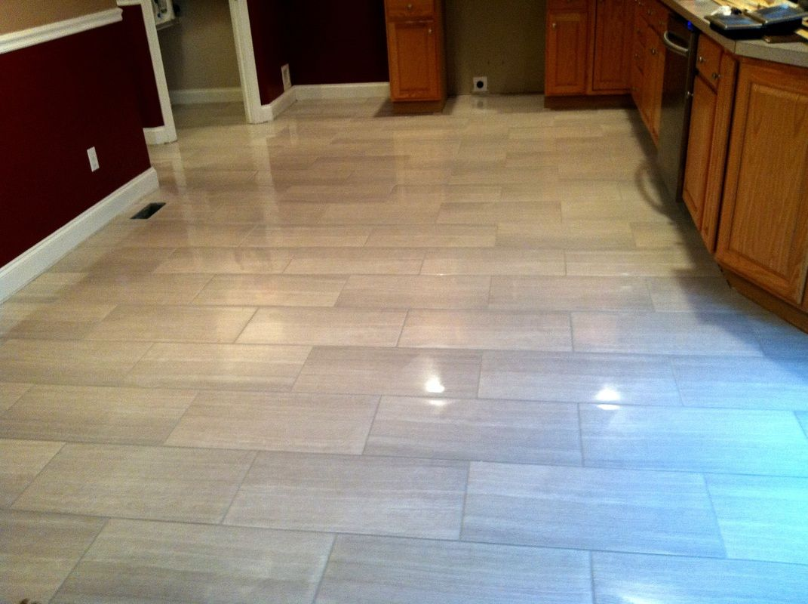
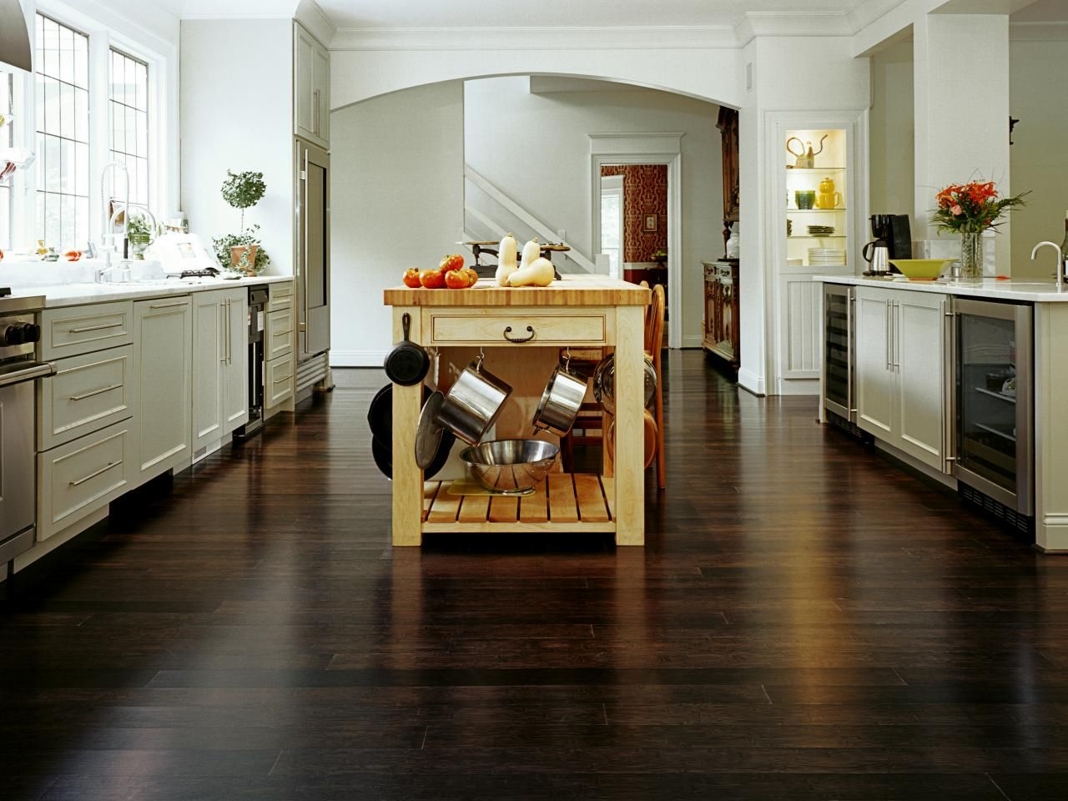
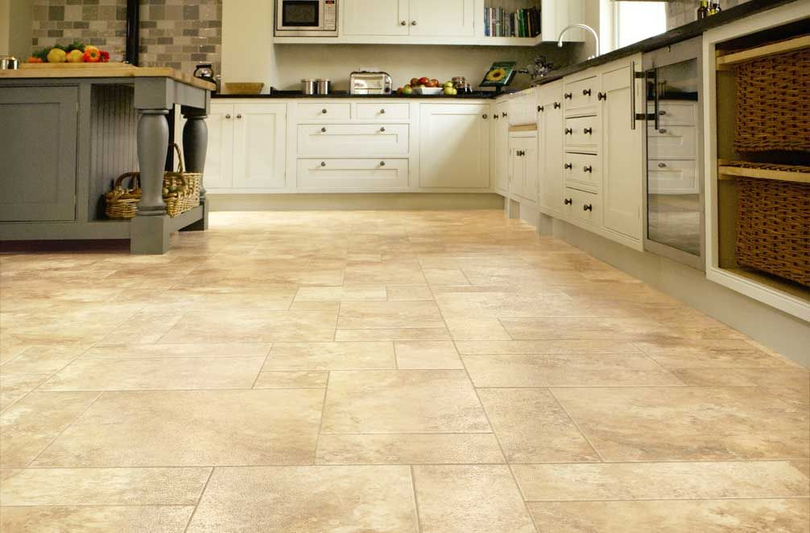
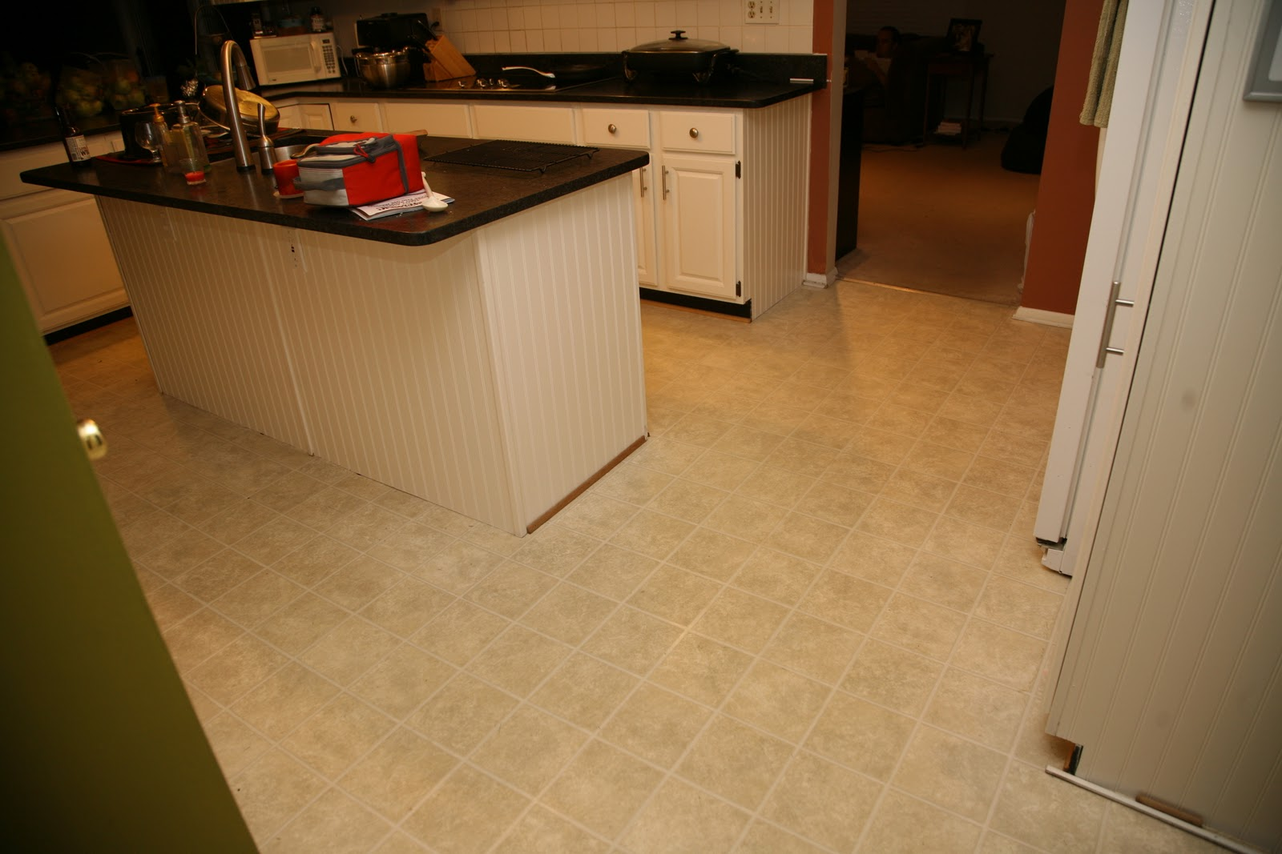
Notes:
These are some of the kitchen floors. I wanted to distinguish the kitchen floor from the overall floor, as I wanted to show that there are two places where action happens. In the overall, area we have customers running from bar to bar, whilst on the kitchen floor we have the chef running. This also allows me to make the kitchen floor more varied as there isn’t that much going on in there. Most of the floors above appear to use tiles for the kitchen, and only few use wood or stone. That’s why I will go with the tiles, as that will help the players understand that the following area is the kitchen space.
Most of these floors are really bright, and I think I will want to make them darker to create a better contrast between the floor and the customers/chef. This will also help the speech bubbles to be more visible.

